Slide 1
Environmental aspects
Diana Hmelevska, Head of Baltic Banking ESG Risk
Swedbank Baltics AS
9 December 2025
MSCA Training - History and prospects of Digital Finance
University of Naples Federico II

Slide 2

Introduction to the Sustainability Framework: Sustainability, Climate, ESG, CSR, SDG, or other letters?
9:10-9:45
Lecture
This Photo by Unknown Author is licensed under CC BY-NC-ND

Slide 3

Setting the scene

Slide 4
CSR: Corporate Social Responsibility
1950s–1970s
What? A business model where companies voluntarily integrate social and environmental concerns into operations, beyond profit-making. Strategic CSR is a long-term approach to creating a net positive social impact based on brand alignment, stakeholder integration and ethical behaviour
Why? It emerged as companies began formalizing philanthropy and ethical practices. But it first came through as socially responsible investing (SRI) which emerged as a way for investors to align their portfolios with their values. This movement gained momentum in the 1980s with the divestment campaigns against companies doing business in South Africa during apartheid. Over time, SRI steadily evolved to look much like today’s corporate social responsibility (CSR) and was focused primarily on social issues such as human rights and supply chain ethics.
Notes:
Carroll, A. B. (1991). “The Pyramid of Corporate Social Responsibility.” Business Horizons.
→ Established the four-part model (economic, legal, ethical, philanthropic) that remains foundational in CSR theory.
Recent synthesis: Decoding CSR: synthesis of top 100 studies (Al-Asfour, 2025) reviews the most cited CSR papers and their influence

Slide 5
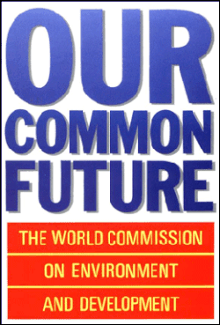
Sustainability
1970s–1980s
The ability to continue over a long period of time
What? Development that meets the needs of the present without compromising the ability of future generations to meet their own needs
Why? Gained traction after environmental movements and the Brundtland Report (1987, “Our Common Future: The World Commission on Environment and Development”, by the UN World Commission on Environment and Development), where the three pillars or principles of environmental, social, and economic sustainability were introduced.
Notes:
- Brundtland Report (1987). “Our Common Future.” World Commission on Environment and Development.
→ Defined sustainability as meeting present needs without compromising future generations.
- Rockström et al. (2009). “Planetary Boundaries: Exploring the Safe Operating Space for Humanity.” Nature.
→ Introduced the planetary boundaries framework, a landmark in sustainability science

Slide 6
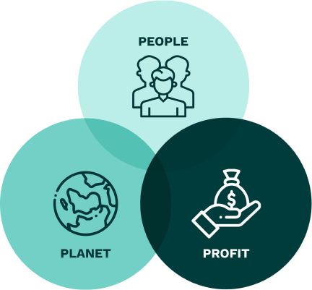
PPP: People, Planet, Profit
1990s
What? Triple Bottom Line – a framework introduced in 1994 by John Elkington
(Cannibals with Forks: the Triple Bottom Line of 21st Century Business, 1998)
Why? John Elkington coined “People, Planet, Profit”, urging companies to measure success not just by profit but also by social and environmental impact.
Notes:
- Elkington, J. (1994). “Towards the Sustainable Corporation: Win-Win-Win Business Strategies.” California Management Review.
→ Introduced the triple bottom line framework.
- Molina & Rajagopal (2023). “People, Planet, and Profit: Crossing the Triple Bottom Line.” Springer.
→ Explores how TBL drives innovation and collaboration across academia, industry, and society.

Slide 7
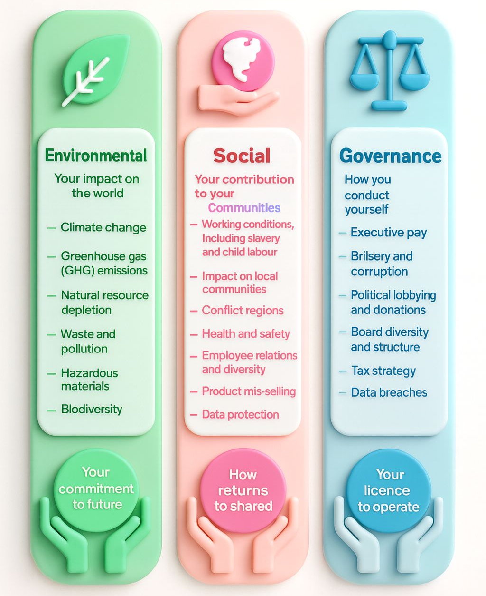
ESG: Environmental, Social, Governance
2004
What? A set of criteria used by investors to evaluate companies’ ethical impact and sustainability practices, in short, almost a reporting frame. The term introduced by UN Global Compact in “Who Cares Wins” report (2004)
Why? The report illustrated how to integrate ESG factors into a company’s operations, breaking down the concept into its three basic components: environmental, social and governance (or corporate governance). Slowly but surely, institutional investors started to recognize that companies could potentially improve financial performance and risk management by focusing on ESG issues like greenhouse gas emissions. In response, asset managers began to develop ESG strategies and metrics to measure the environmental and social impact of their investments
Notes:
- UN Global Compact (2004). “Who Cares Wins.”
→ Introduced ESG as a framework for responsible investment.
- Friede, Busch & Bassen (2015). “ESG and Financial Performance: Aggregated Evidence from More than 2000 Empirical Studies.” Journal of Sustainable Finance & Investment.
→ Landmark meta-study showing positive links between ESG and financial performance

Slide 8
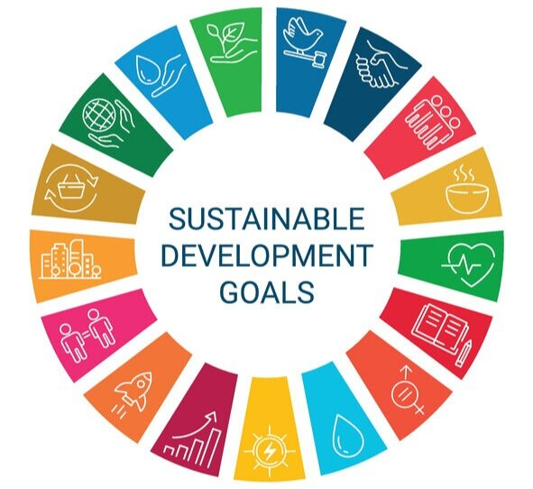
SDG: Sustainable Development Goals
(2000) 2012-2015
What? 17 global goals adopted by the UN in 2015.
Why? SDG aim to achieve peace, prosperity, and environmental protection by 2030. In 2000, the United Nations hosted world leaders in New York at the Millennium Summit to discuss their evolving role in the new millennia. Over the course of the three-day summit, leaders established guiding principles around topics like human rights, working conditions, the environment and anti-corruption. Following the summit, the Millennium Development Goals (MDGs) were created, outlining eight international development goals to be achieved by 2015. While meant to spark discussion, the MDGs ultimately set the stage for nations and corporations to discuss ESG factors more candidly. The previously developed Millennium Development Goals launched (2000); Rio+20 Summit (2012) set stage for SDGs since the millennium goals have arguably failed the operationalization and execution effort.
Notes:
- Sachs, J. D. (2012). “From Millennium Development Goals to Sustainable Development Goals.” The Lancet.
→ Pioneered the transition from MDGs to SDGs, framing global development priorities.
- Sianes et al. (2022). “Impact of the Sustainable Development Goals on the Academic Research Agenda.” PLOS One.
→ Scientometric analysis showing how SDGs reshaped global research directions.

Slide 9
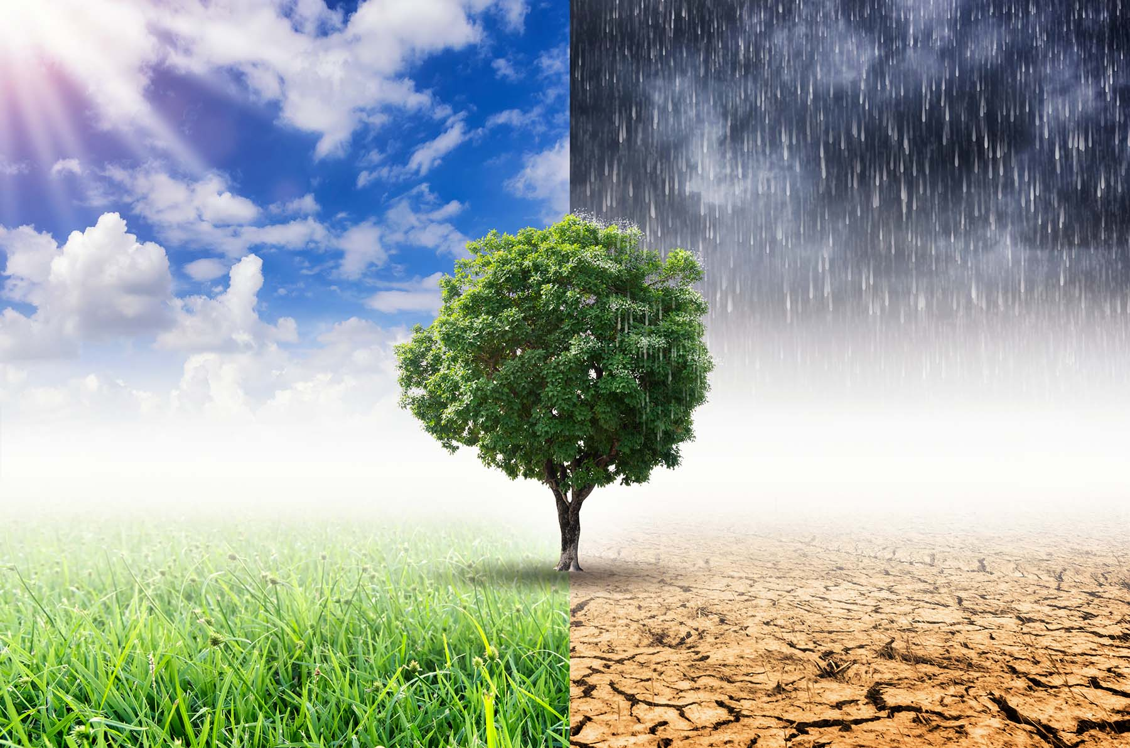
C&N: Climate and Nature
2017-Present
What? Risks to economies and businesses from climate change (e.g., extreme weather) and nature degradation (e.g., biodiversity loss, resource depletion)
Why? It reflects a shift from broad aspirational frameworks like the SDGs toward urgent, measurable risks that directly affect financial stability, corporate strategy, and global security – a systemic risk. While the SDGs remain a guiding vision, climate and biodiversity crises are now seen as systemic risks that can derail progress on all 17 goals. TCFD (climate disclosure) and TNFD (nature disclosure) frameworks developed.
Notes:
- Stern Review (2006). “The Economics of Climate Change.” UK Government.
→ Groundbreaking economic analysis of climate risk, showing costs of inaction outweigh mitigation.
- Oxford Study (2023). “$5 trillion in nature-related global economic risks.” University of Oxford.
→ Quantified the massive financial risks from biodiversity loss and ecosystem degradation.
- Petutschnig et al. (2023). “Impact Chain Based Climate Risk Assessments.” Frontiers in Climate.
→ Advanced methods for local climate risk and vulnerability analysis.

Slide 10


Coming together
Connections and Differences
Risks and Trade-offs
CSR vs ESG | CSR is voluntary and company-driven; ESG is investor-driven with measurable criteria.
Sustainability vs SDGs | Sustainability is the overarching principle; SDGs are specific, measurable targets to achieve it.
PPP vs CSR | Both emphasize responsibility, but TBL formalizes measurement across social, environmental, and financial dimensions
Climate & Nature Risk vs ESG | ESG includes climate/nature risk as part of its environmental pillar, but risk frameworks (TCFD/TNFD) provide detailed disclosure standards.
PPP vs SDGs | TBL is a corporate lens; SDGs are global policy goals. Both align on balancing social, environmental, and economic priorities.
CSR | Can be superficial (“greenwashing”) if not embedded in strategy.
Sustainability | Requires systemic change, not just corporate initiatives.
SDGs | Ambitious but challenging to achieve by 2030.
ESG | Criticized for inconsistent metrics and “ESG-washing.”
Climate & Nature risk | Underestimated risks can lead to financial instability.
PPP | Difficult to measure social and environmental impact with the same rigor as profit.

Slide 11
